Slide 1

Session 6
Selenium WebDriver - Synchronizing Tests

Slide 2
Knowledge Check
Session 5
How to Perform Keyboard and Mouse events in WebDriver?
How to perform a Action?
What is Context Menu?
Explain JavasctiptExecutor.
What are different browser navigation functions?

Slide 3
Topics
Covered
Synchronizing a test with an implicit wait
Synchronizing a test with an explicit wait
Synchronizing a test with custom-expected conditions
Synchronizing a test with FluentWait

Slide 4

Synchronizing a test with an
implicit wait
When an implicit wait is implemented in tests, if WebDriver cannot find an element in the DOM, it will wait for a defined amount of time for the element to appear in the DOM. Once the specified wait time is over, it will try searching for the element once again. If the element is not found in specified time, it will throw the NoSuchElement exception.
Implicit wait is a single line of a code and can be declared in the setup method of the test script.

Slide 5
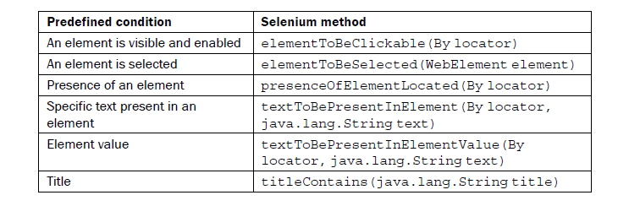
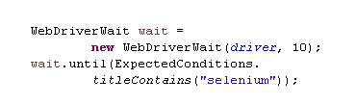
Synchronizing a test with an
explicit wait
Explicit waits are used to halt the execution till the time a particular condition is met or the maximum time has elapsed.
The Selenium WebDriver provides the WebDriverWait and ExpectedConditions classes to implement an explicit wait.

Slide 6
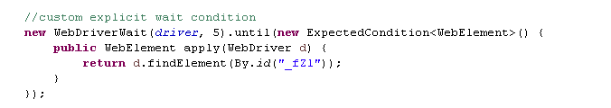
Synchronizing a test with custom-expected conditions
With the explicit wait mechanism, we can also build custom-expected conditions along with common conditions using the ExpectedConditions class.
This comes in handy when a wait cannot be handled with a common condition supported by the ExpectedConditions class.

Slide 7
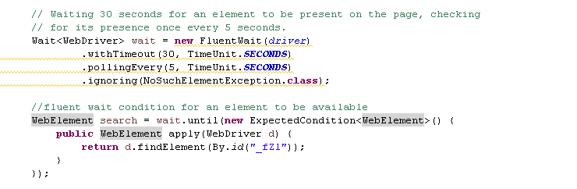
Synchronizing a test with
FluentWait
Unlike implicit and explicit wait, FluentWait uses a maximum timeout value and polling frequency.

Slide 8


Slide 9
Knowledge Check
What are different types of waits available in WebDriver?

